Slide 1
Finding the optimal location for an Indian restaurant in London
By Ismael Siffon

Slide 2
Problem description
In this project, we are going to help a restaurateur pick the location of his new Indian restaurant in London. With the increasing rate at which Indian cuisine is becoming popular in the UK, our restaurateur has some specific requirements for his location:
Safety: high crime should be avoided.
Costumer profile: high Indian population density, or other nationalities that have similar cuisine.
Competition: should not be crowded with Indian restaurants.
Customer purchasing power: middle-class income.
Location affordability: Rent should be affordable.

Slide 3
Data gathering and cleaning
Demographic data of all boroughs in London:
Population density
Average age
Largest, second and third migrant population and percentage
Employment rate
Gross annual pay
Crime rate, among others.
List of neighborhoods and their coordinates:
Web-scrapping from Wikipedia
Google API
Foursquare data:
The number of Indian restaurants
The number of likes
The rating

Slide 4
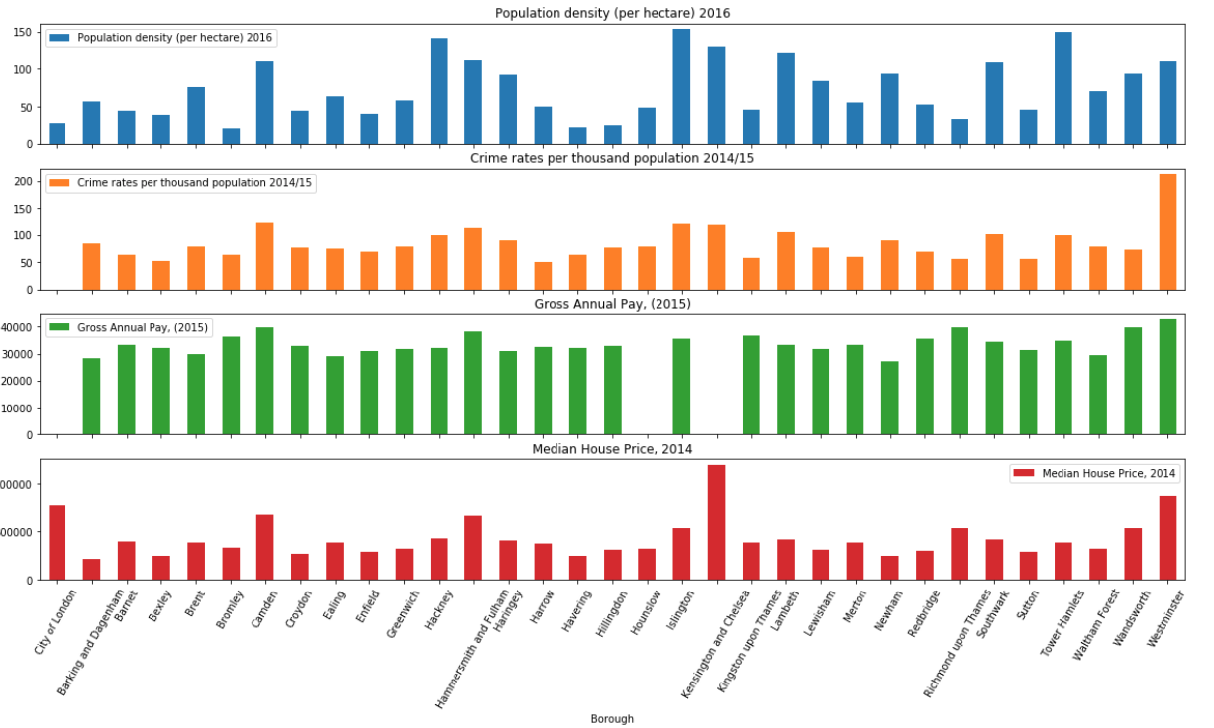
Data gathering and cleaning

Slide 5
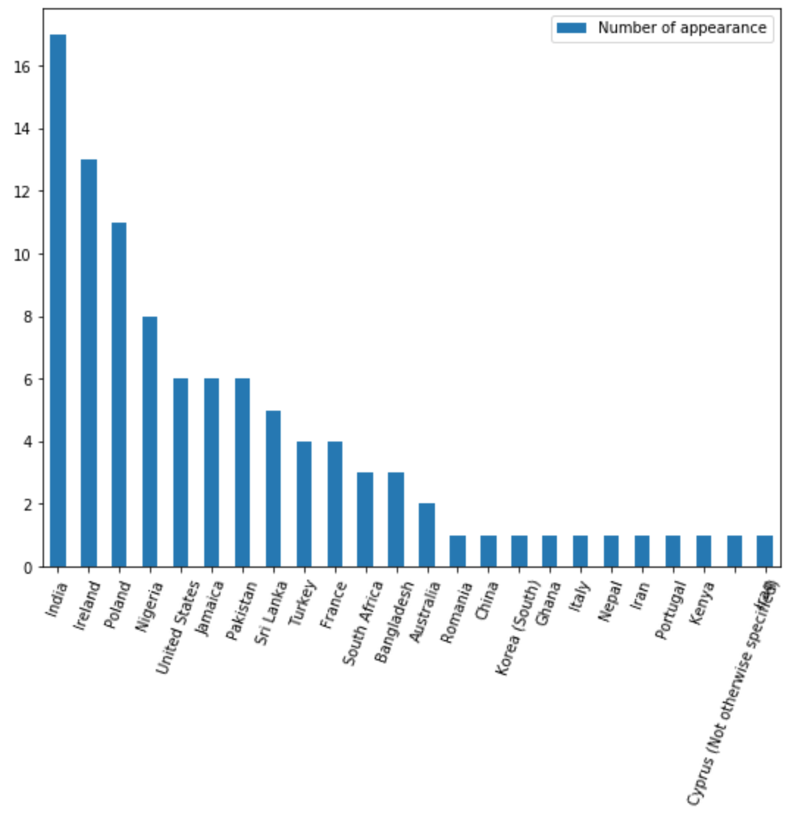
Data gathering and cleaning
India: Highest number of appearance
Pakistan: 7th
Sri Lanka: 8th

Slide 6
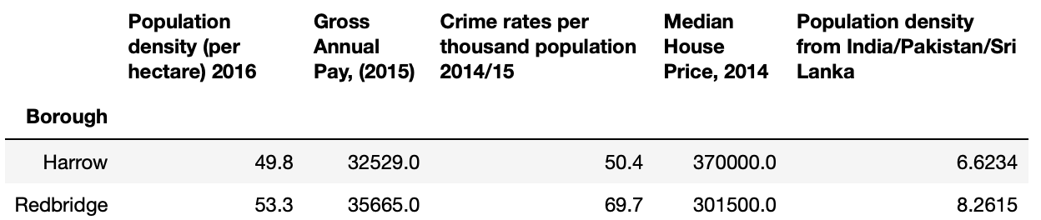
Data filtering
Conditions applied to boroughs:
Crime rate < 75th percentile
Density from India/Pakistan/Sri Lanka > 2 people per hectare
Gross pay > £30,000
Median house price < £500,000
We left with only 2 boroughs: Harrow and Redbridge

Slide 7
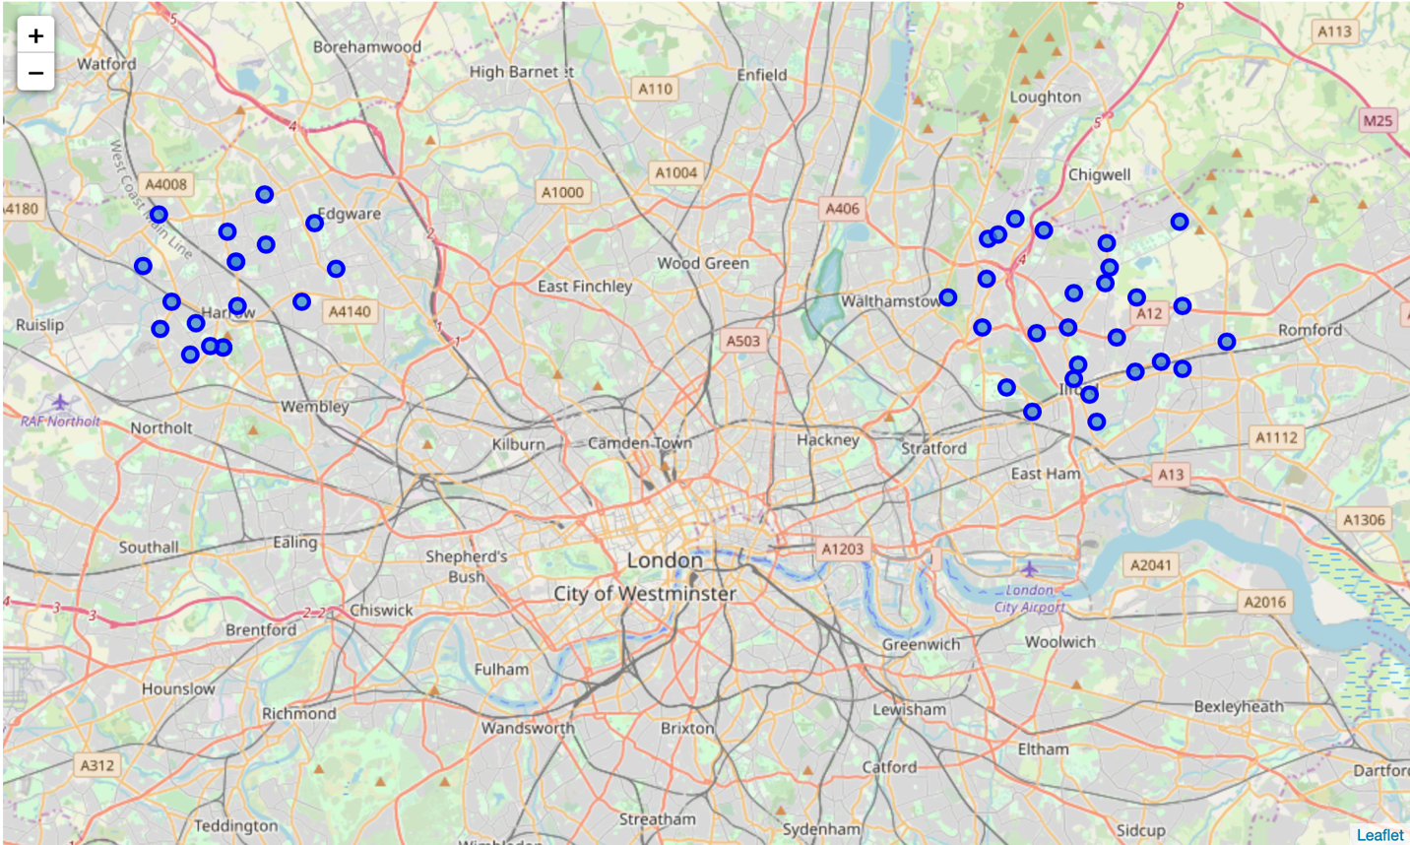
Map of neighborhoods
Redbridge
Harrow
There is a total of 42 neighborhoods

Slide 8
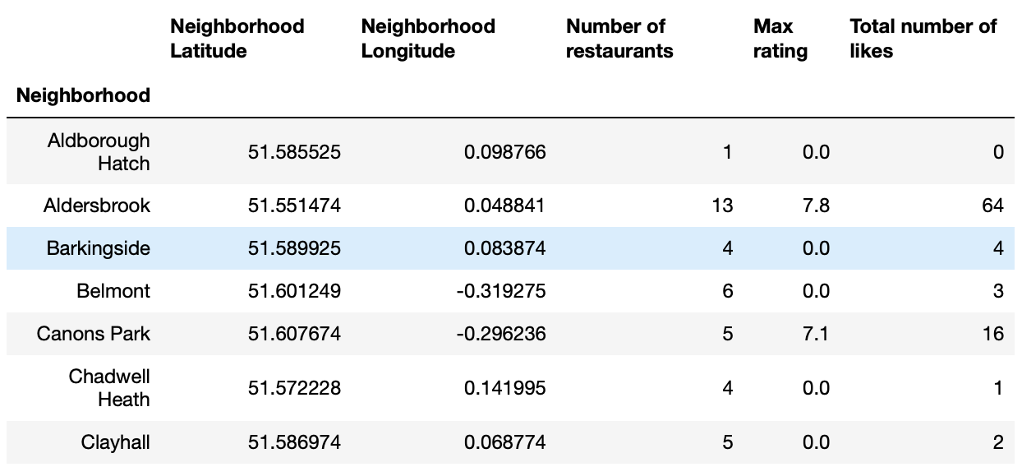
Foursquare data
Data retrieved from Foursquare for each neighborhood:
The number of Indian restaurants
The highest restaurants' ratings
The total number of likes

Slide 9
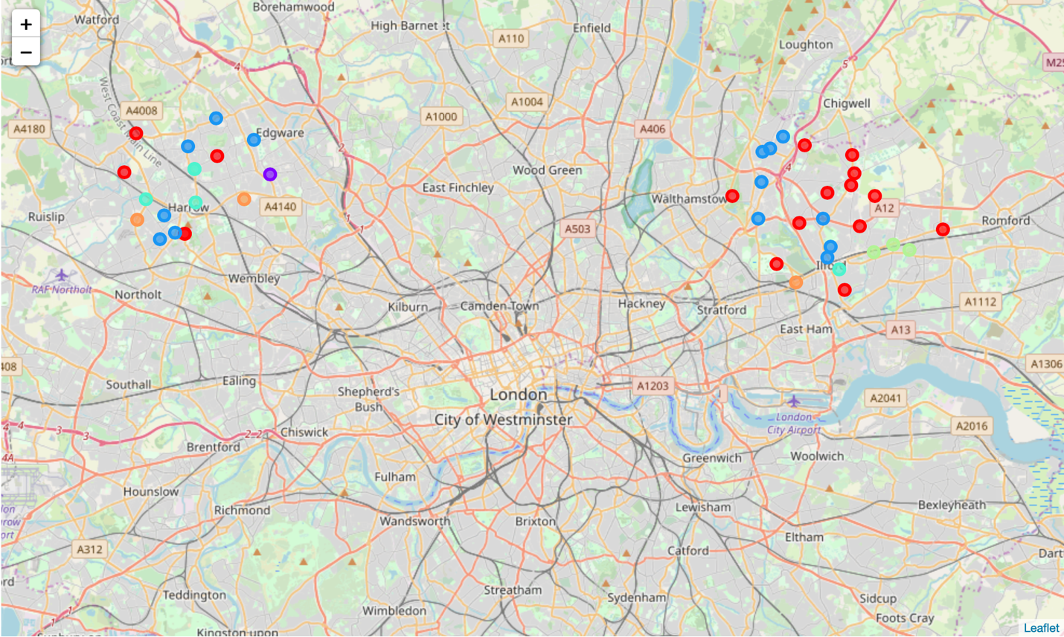
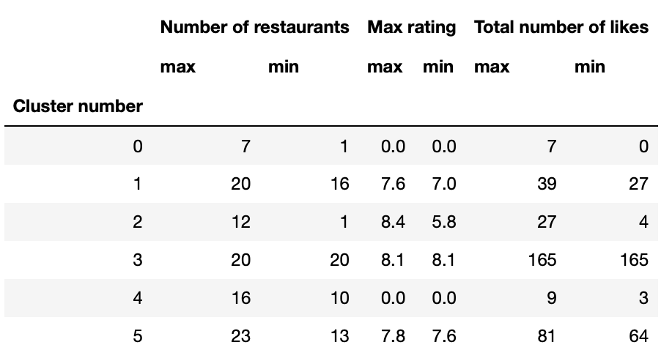
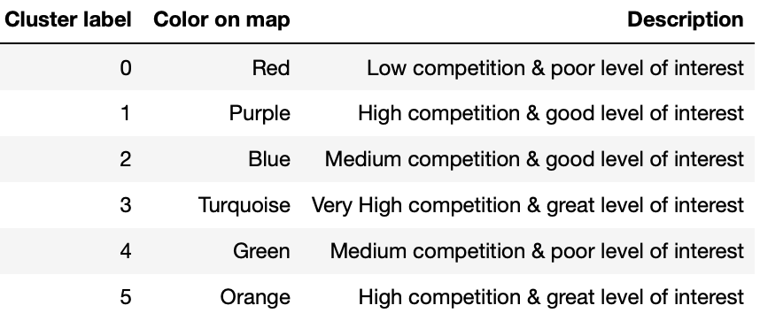
Clustering
We would recommend neighborhoods in cluster 2 (blue on map)

Slide 10
Conclusion
Based on the requirements from the stakeholder and the demographic data of London, only 2 boroughs are qualified for the new location of our Indian restaurant. Harrow and Redbridge.
There are a total of 42 neighborhoods in Harrow and Redbridge. Using data from Foursquare, the 42 neighborhoods can be clustered
We recommend the stakeholder to open his new restaurant in on of the neighborhoods in cluster 2, which includes a total of 14 neighborhoods.
The stakeholder is free to make a different choice, depending on what competition level of population interest level they are looking for.

